Slide 1
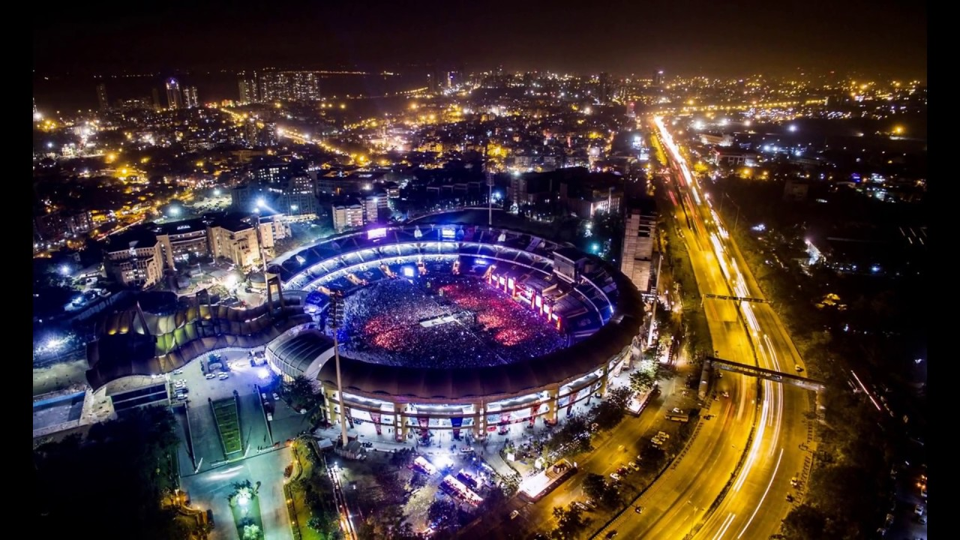
Exploring Places in Mumbai
NIRMAL KIROLA

Slide 2
Exploring Food Venues
Whenever a person searches for a venue in a new city, they’re highly interested in the best places that the city has to offer.
The person might want to know how good a given restaurant is .
A restaurant could be chosen considering the following charactistics:
Location
User Raings
Price Range
Category
Combining the location of the venues in the city with their price and rating information would surely help visitors in a city make better informed decisions about the places they should visit.

Slide 3
Data Collection
The data of the various restaurants in Mumbai was fetched from the Foursquare API and the Zomato API within a range of 4 km.
These APIs store the information about the Restaurants in Mumbai.
The APIs are open for developers for using these APIs for Building Various Projects.
A map of the venues with specific color attributes will be plotted to highlight their position, and information about these venues.
This enables any visitor to take a quick glance and decide what place to visit.

Slide 4
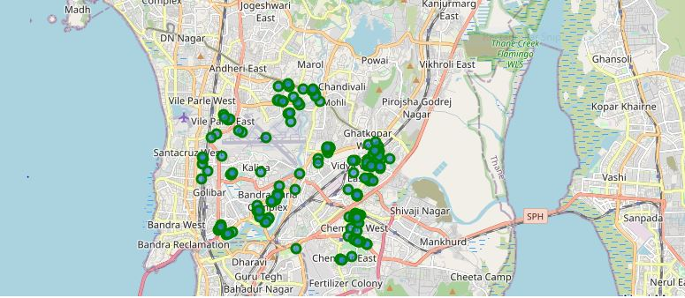
Foursquare API Data
Clusters were found near Ghatkopar, Chembur, Marol Naka, Bandra Complex and Santa Cruz.

Slide 5
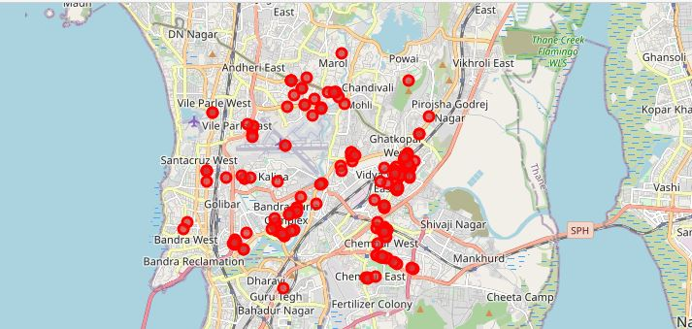
Zomato API Data
Clusters were found near Ghatkopar, Chembur, Marol Naka and Bandra Complex.

Slide 6
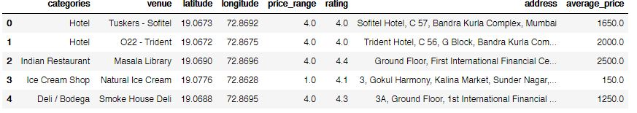
Data aggregated from both APIs
This is the data of the first five places which is being used in this Project.

Slide 7
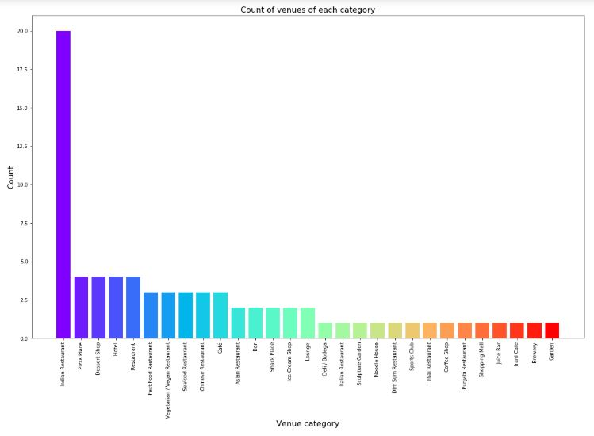
Category of Venues
The Major Category of the Venues in Mumbai is Indian Restaurants.

Slide 8
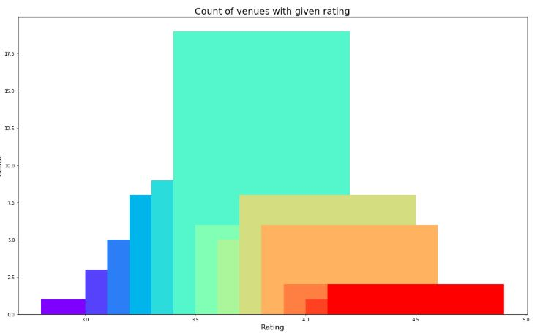
Rating and Count of Venues
The average rating of the Restaurants in Mumbai is 3.75.

Slide 9
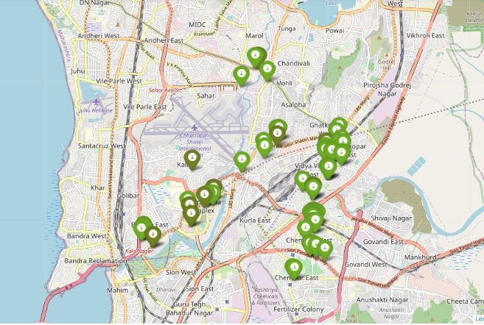
Plot of Venues with different Ratings
Most of the Restaurants have Ratings from 3 to 4.

Slide 10
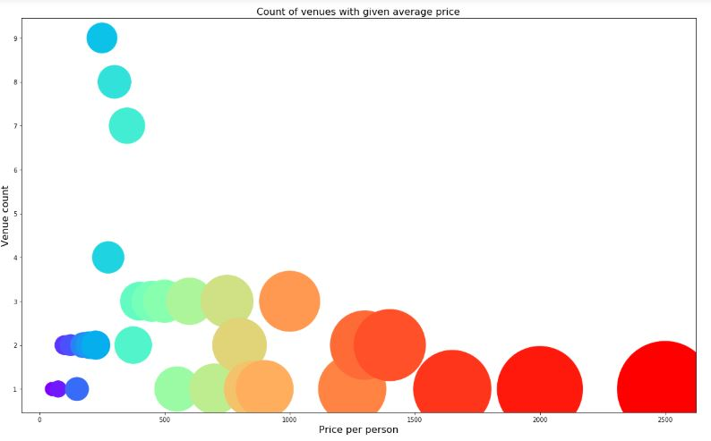
Price per person and Count of Venues
The most of the Restaurants in Mumbai have price range from Rs 500 to Rs 1000.

Slide 11
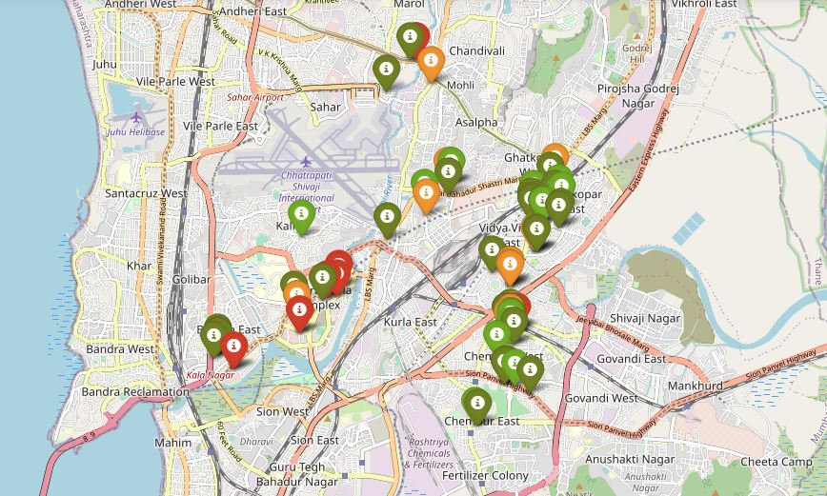
Plot of Venues with different Prices
Most of the Restaurants have Price Range from Rs 500 to Rs 1000.

Slide 12
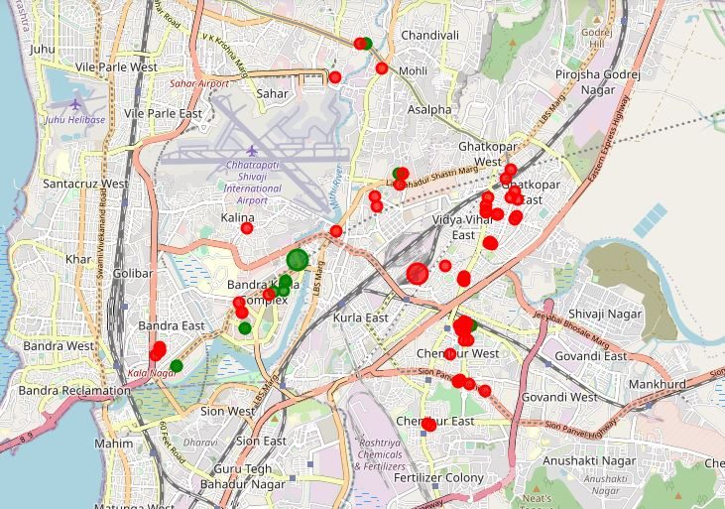
Cluster of Venues
In figure, we see the two clusters:
The first cluster (red) is spread across the whole city and includes the majority venues. These venues have mean price range of 2.02 and rating spread around 3.79.
The second cluster (green) is very sparsely spread and has very limited venues. These venues have mean price range of 3.92 and rating spread around 4.17.

Slide 13
Conclusion
The purpose of this project was to explore the places that a person visiting Mumbai could visit. The venues have been identified using Foursquare and Zomato API and have been plotted on the map. The map reveals that there are three major areas a person can visit: Ghatkopar, Bandra Complex and Chembur. Based on the visitor's venue rating and price requirements, he/she can choose amongst the three places.

